Slide 1
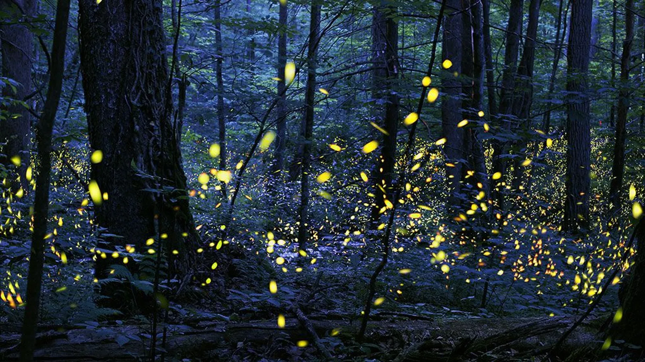
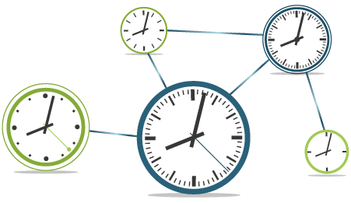

Synchronization
Introduction
Synchronization: A phenomenon in which multiple oscillators vibrate homogeneously through interaction
A system where clocks spinning at different speeds adjust their speed by looking at the clock connected to them?
Synchronization of fireflies, synchronization of applause at concert halls, etc.

Slide 2
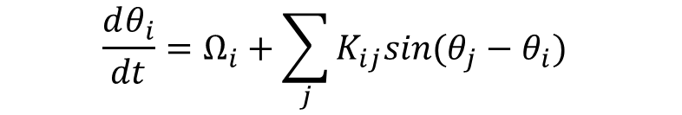
Kuramoto model
Introduction
Angular velocity of node i
Interaction intensity
synchronized
$$\frac{dθ_{i}}{dt}=Ω_{i}+\sum_{j}{K_{ij}sin⁡(θ_{j}−θ_{i}) }$$
desynchronized
natural frequency
Interaction with surrounding nodes
Kuramoto model: the simplest model for synchronization
A state where everyone looks at each other and applauds.
Depending on the interaction strength (K), the system can be synchronized or desynchronized.

Slide 3
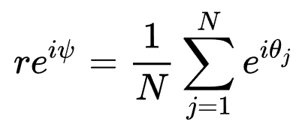
Kuramoto model
Introduction
synchronized
r=0.95
r=0.2
desynchronized
Order parameter: A variable that expresses how well the synchronization is (0~1)
The larger r, the better the synchronization.

Slide 4
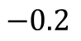
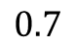
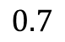
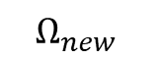
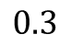
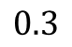

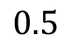
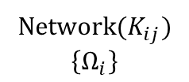
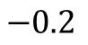
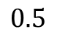
Optimal frequency for growing network
Introduction
$$0.3$$
$$0.3$$
$$0.5$$
$$0.5$$
$$Ω_{new}$$
$$0.7$$
$$0.7$$
$$−0.2$$
$$−0.2$$
r=0.4
r=?
Network${(K}_{ij})$ $$\left\{Ω_{i}\right\}$$
$$Ω_{new}$$
Algorithm
Question: When adding a new node to a network, how should its natural frequency be assigned?
Compute the frequency to preserve or improve the original network’s order parameter 𝑟.
An algorithm that infers the new node’s frequency from the existing network and its frequency distribution.

Slide 5
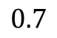
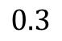

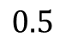
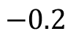
Optimal frequency for growing network
Introduction
Global: Average of all existing node frequencies
Local: Average value of adjacent nodes (red)
Random: Just random (normal distribution)
SAF
ALF
$$0.3$$
$$Ω_{new}$$
$$0.5$$
$$0.7$$
$$−0.2$$
r=?
Grow a given network (30 nodes) to 40 and assign frequencies to new nodes in 5 ways.
Comparison of r at the beginning and r at the end
What is the best way to increase the r of the network?

Slide 6
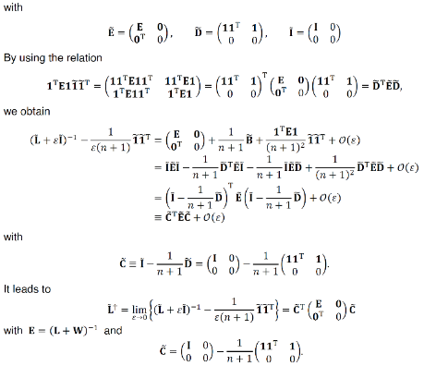
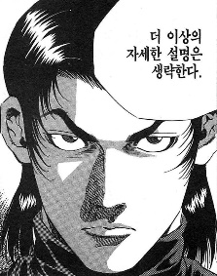
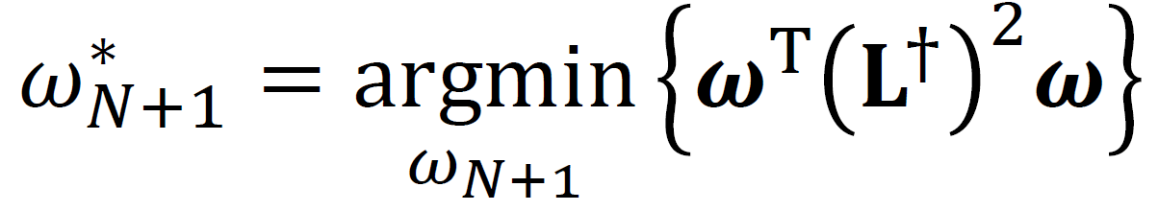
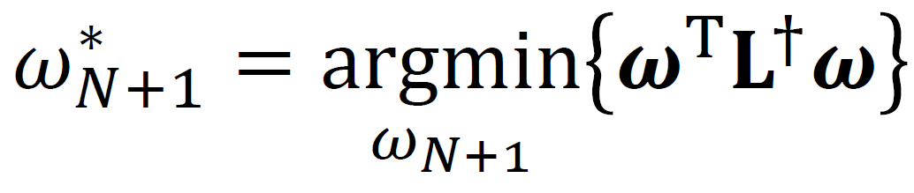
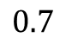
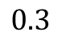
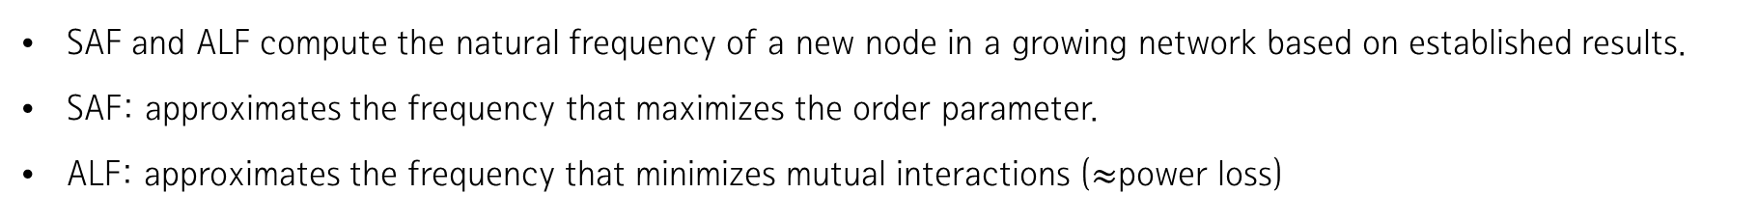

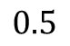
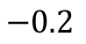
Optimal frequency for growing network
Introduction
induction:
SAF: I want to increase the order parameter as much as possible.
$$0.3$$
ALF: We want to reduce the power loss of the entire network as much as possible.
$$Ω_{new}$$
$$0.5$$
$$0.7$$
$$−0.2$$
SAF and ALF compute the natural frequency of a new node in a growing network based on established results.
SAF: approximates the frequency that maximizes the order parameter.
ALF: approximates the frequency that minimizes mutual interactions ($≈$power loss)

Slide 7
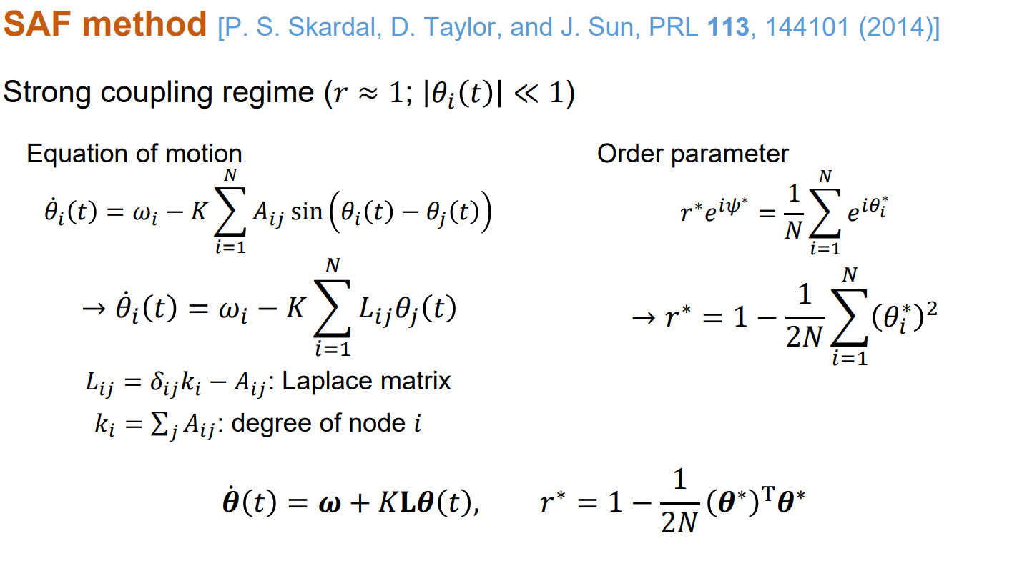

Slide 8
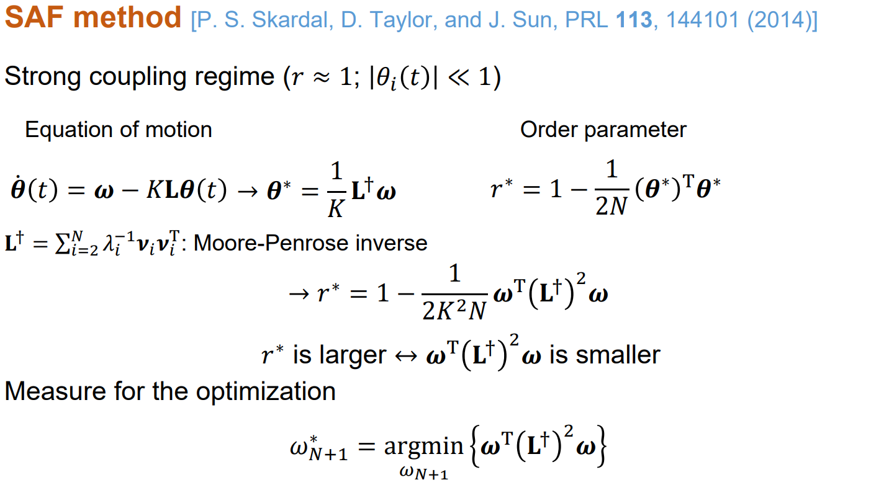

Slide 9
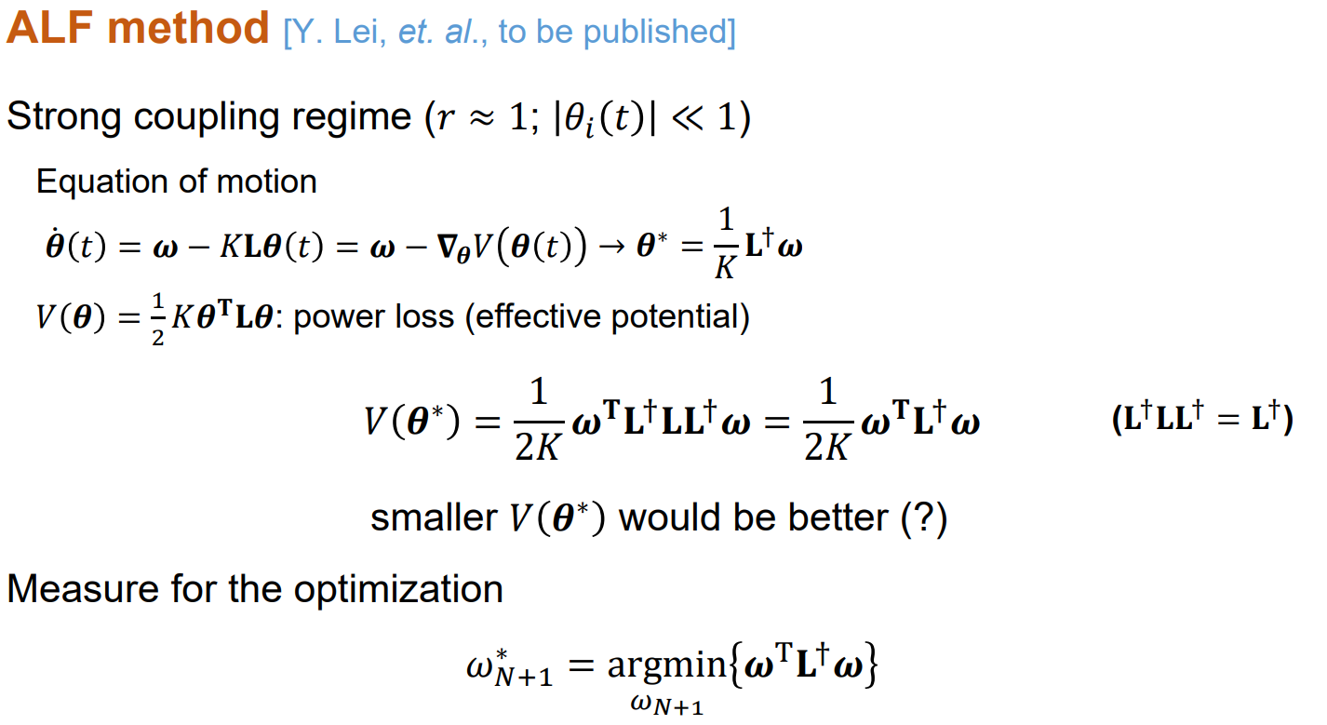

Slide 10
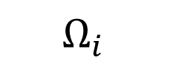
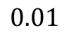
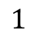
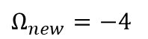

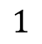
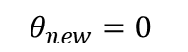
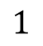
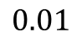
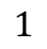
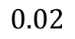
Optimal frequency for growing network
Introduction
ALF: We want to reduce the power loss of the entire network as much as possible.
Dummy network
$$Ω_{i}$$
$$θ_{i}$$
$$1$$
0.02
$$1$$
$$0.01$$
$$Ω_{new}=−4$$
$$θ_{new}=0$$
$$0.02$$
$$1$$
$$1$$
$$0.01$$
Another interpretation of ALF: construct a dummy network where all existing nodes are assigned an angular velocity of 1.
In its synchronized state, a larger phase difference with the new node leads to stronger influence on its assigned frequency.
The new node’s angular velocity is determined by weighting green nodes by 1 and red nodes by 2.

Slide 11
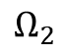
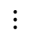
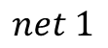
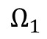
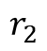
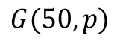
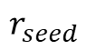
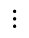
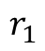
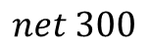





Optimal frequency for growing network
Introduction
$$G(50,p)$$
$$Ω_{1}$$
$$Ω_{2}$$
$$⋯$$
$$Ω_{50}$$
$$net 1$$
$$r_{1}$$
$$net 2$$
$$r_{2}$$
$$ℕ\left(0,1\right)$$
$$⋮$$
$$⋮$$
$$net 300$$
$$r_{300}$$
$$r_{seed}$$
Test method: Create several seed networks using the same settings
Generating the natural frequency of each node as a normal distribution.
The average value of r obtained from 300 networks becomes the representative value of the seed network.

Slide 12










Optimal frequency for growing network
Introduction
$$G(50,p)$$
$$Ω_{1}$$
$$Ω_{2}$$
$$⋯$$
$$Ω_{50}$$
$$Ω_{51}\sim Ω_{60}$$
$$net 1$$
$$r_{1}$$
$$r_{1}$$
$$net 2$$
$$r_{2}$$
$$r_{2}$$
$$y=x$$
$$r_{final}$$
$$ℕ\left(0,1\right)$$
$$Local$$
$$⋮$$
$$⋮$$
$$⋮$$
$$net 300$$
$$r_{300}$$
$$r_{300}$$
$$r_{seed}$$
$$r_{final}$$
$$r_{seed}$$
Test method: Create several seed networks using the same settings
Generating the natural frequency of each node as a normal distribution.
The average value of r obtained from 300 networks becomes the representative value of the seed network.

Slide 13

Result
Introduction
Callaway
BA
Comparison of order parameters while growing 10 more seed networks with N=30
When each column starts from a low r region, a middle region, or a high region
ALF is good in most areas, SAF is a bit ambiguous

Slide 14

Optimal frequency for growing network
Introduction
Callaway
BA
Difference between r of seed network and final r according to network size
In rows 1, 2, and 3, the network sizes are 10~20, 30~40, and 50~60.
ALF is good except for small networks.

